Slide 1
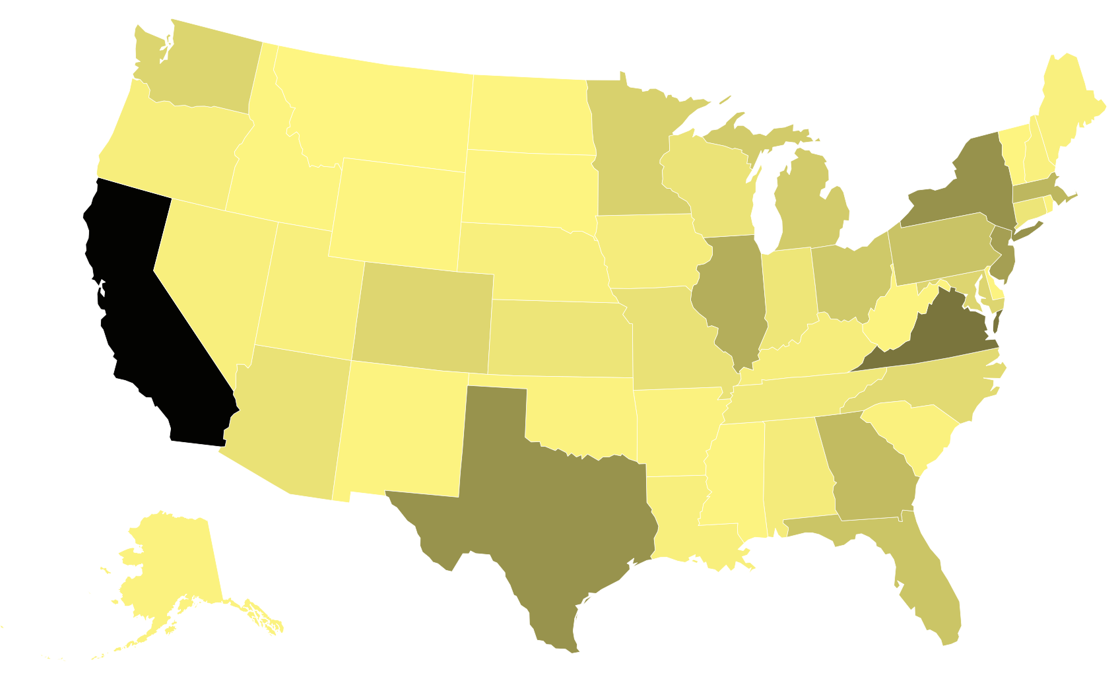
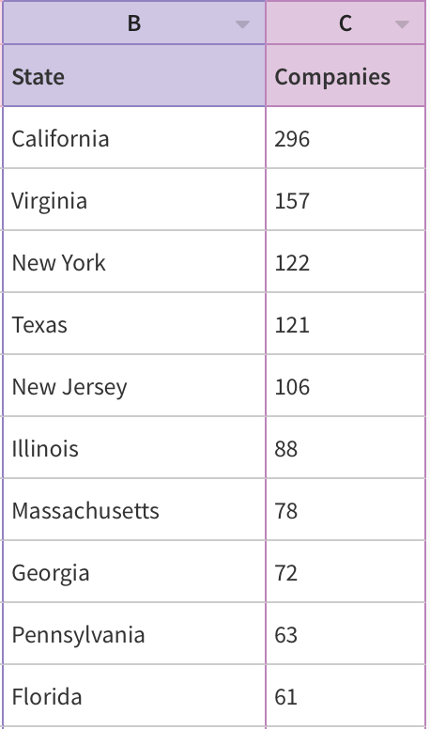
Tech Companies by State
https://app.flourish.studio/visualisation/3412967/edit
Notes:
I tested out three specific industries - technology, retail and finance to observe which specific states were dominating in those industries.
The following outputs were provided: for technology, California is leading with 296 companies, followed by Virginia New York, Texas and New Jersey.
The top five industries in the United States are hospital and healthcare, higher education, information technology and services, education management, and financial services.

Slide 2
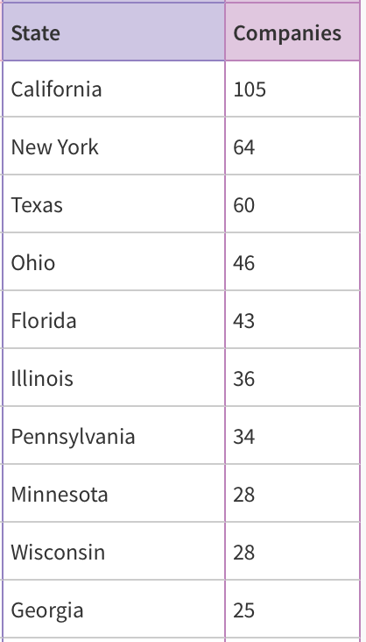
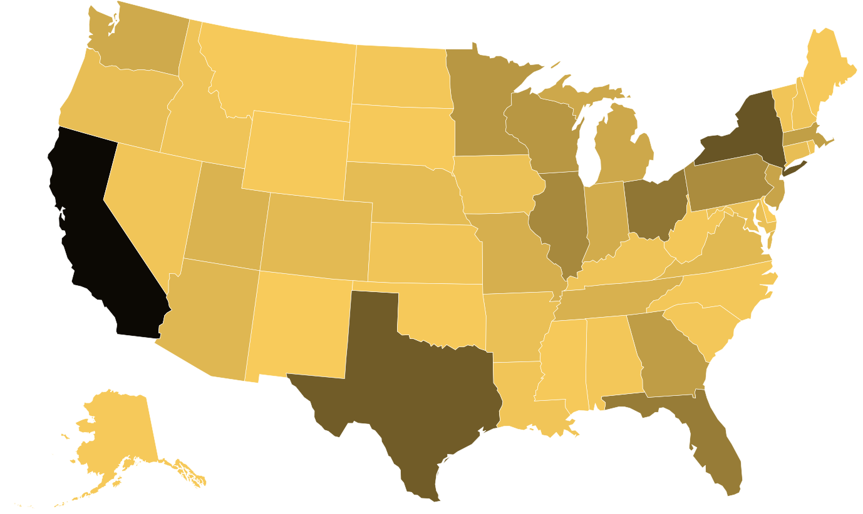
Retail Companies by State
https://app.flourish.studio/visualisation/3412858/edit
Notes:
For retail, California is again taking the lead followed by New York, Texas, Ohio and Florida.

Slide 3
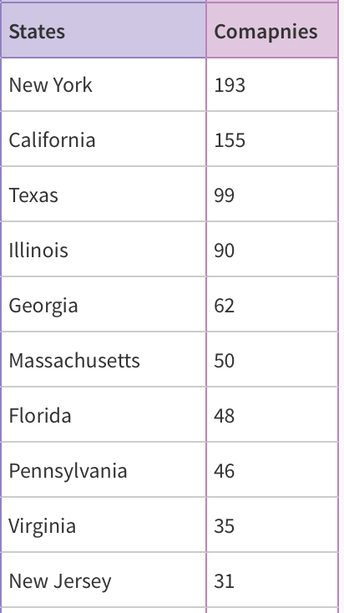
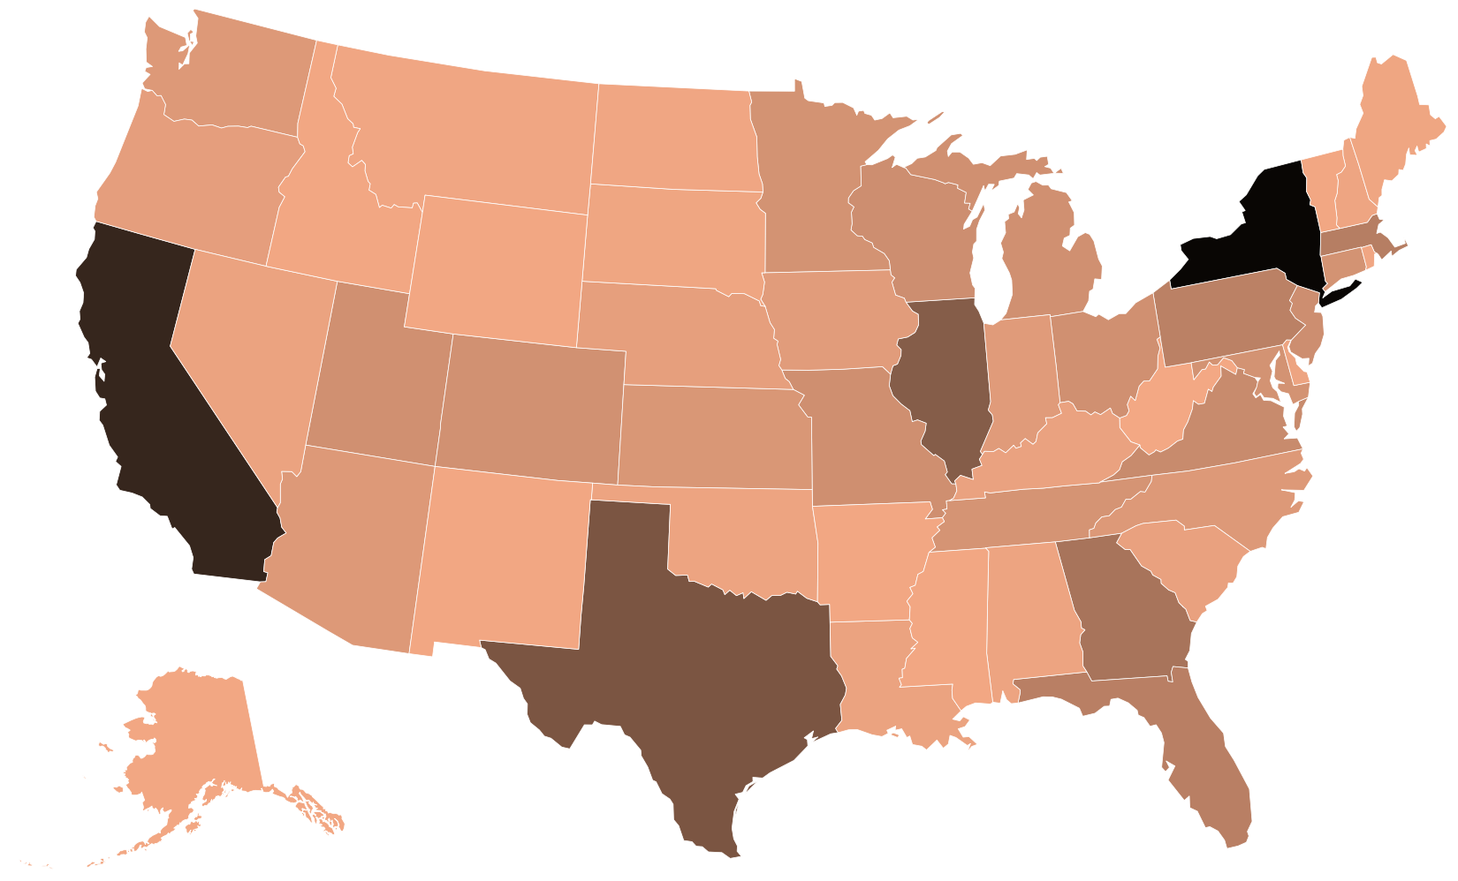
Finance Companies by State
https://app.flourish.studio/visualisation/3413072/edit
Notes:
Lastly, for Finance, New York is again taking a lead followed by California, Texas, Illinois and Georgia.
So, in conclusion, California, New York and Texas are consistently leading in every industry and that remained true for hospital and healthcare, information technology and services and various other industries. Therefore, for a startup or an early careerist, states such as California, New York and Texas seem like an ideal fit. It can be seen as a negative and a positive - with entering a market which is dense, competition is high but for individuals looking for jobs in a dense market, there is an abundance of options and opportunities. Next, Eliesha will speak about the trend in new founded companies in the past 5 years.

Slide 4
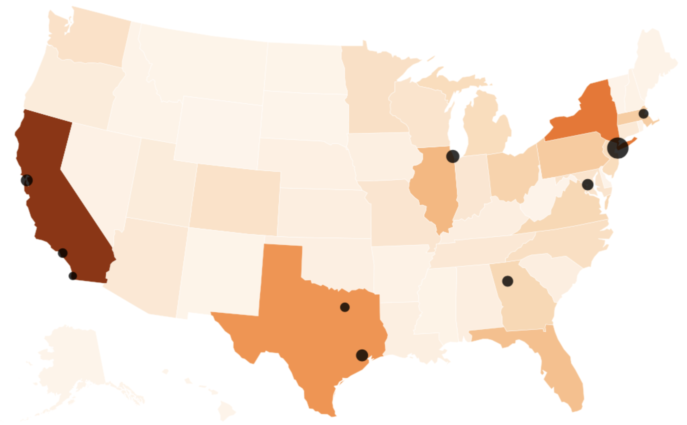
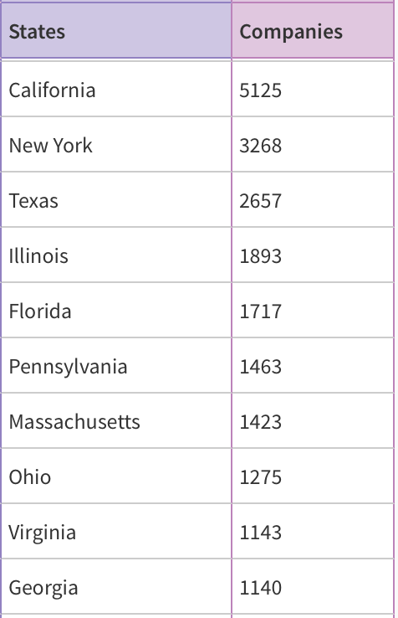
Top 10 Companies by State
https://app.flourish.studio/visualisation/3395333/edit

